Slide 1
UI Design & Evaluation
CO2104
Button To Switch CSS

Slide 2
Button To Switch CSS
When you create a website you normally decide on a style (colour, font style, font size, layout, etc…).
The user as no choice but to accept that design.
But this is not always suitable for all users.
Those that are colour blind or dyslexic can sometime struggle to read/see text with the choices you as a designer have made.
So sometimes it is good to make 2 (or more) different CSS files that the user can then chose from.
One of these options could be a high contrast version so it is easier to read (for example).

Slide 3
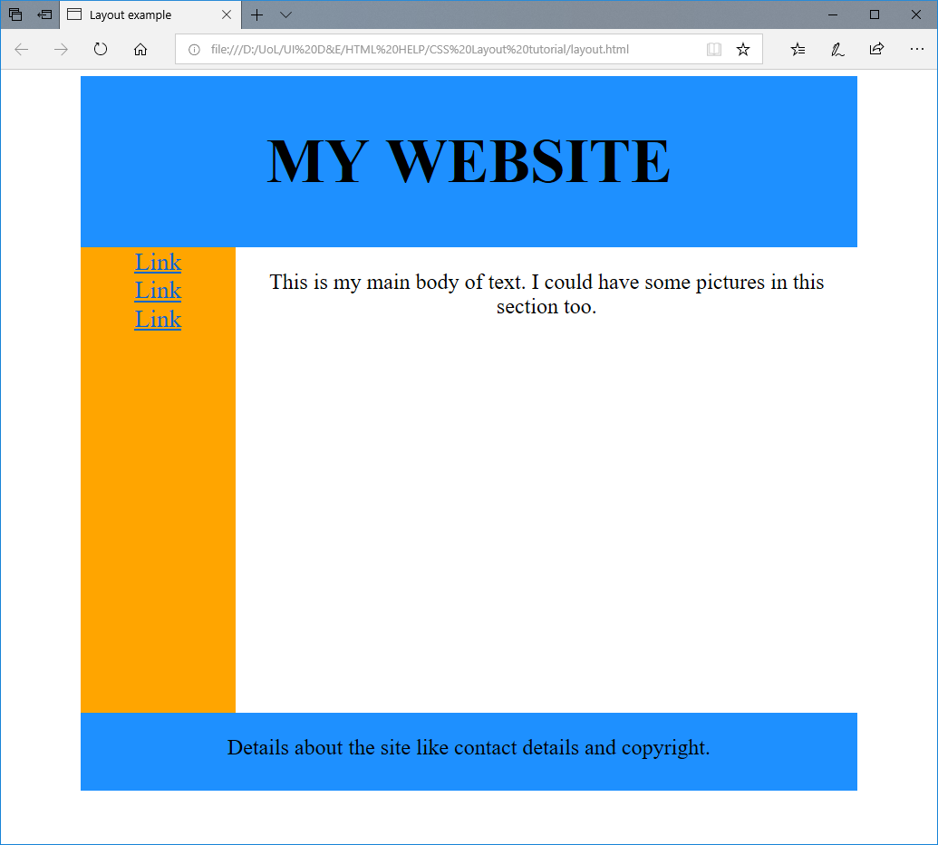
A starting point.
For this example I will be using the template page I made in the first handout in week 7 (CSS Layout tutorial)
This already has a CSS setup.
But I will be making a different CSS which will change the colours and font styles.
Then add 2 button to allow the user to switch between the styles.

Slide 4
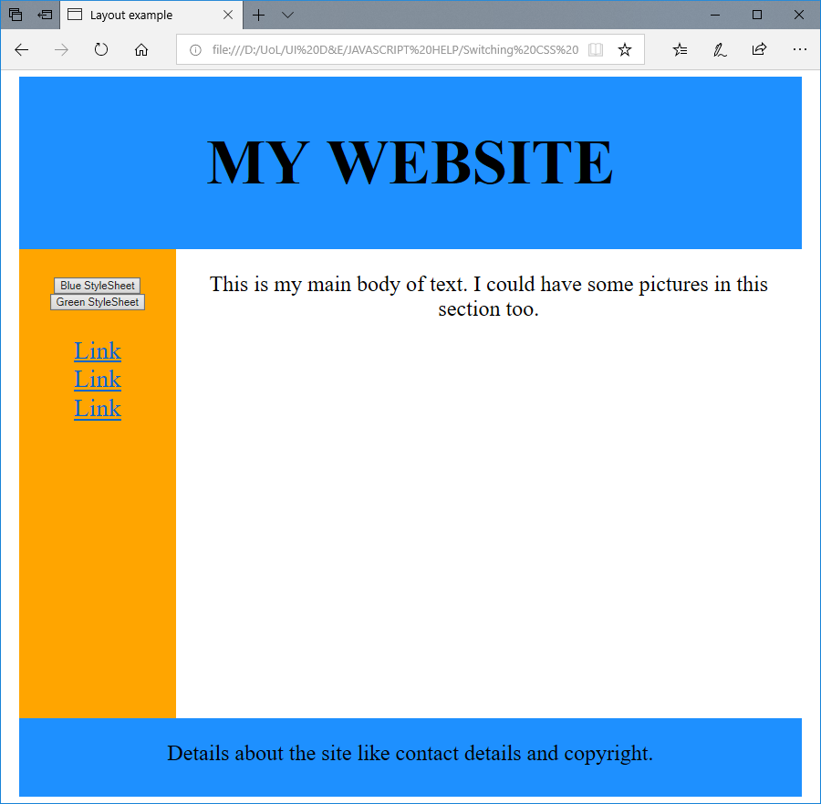
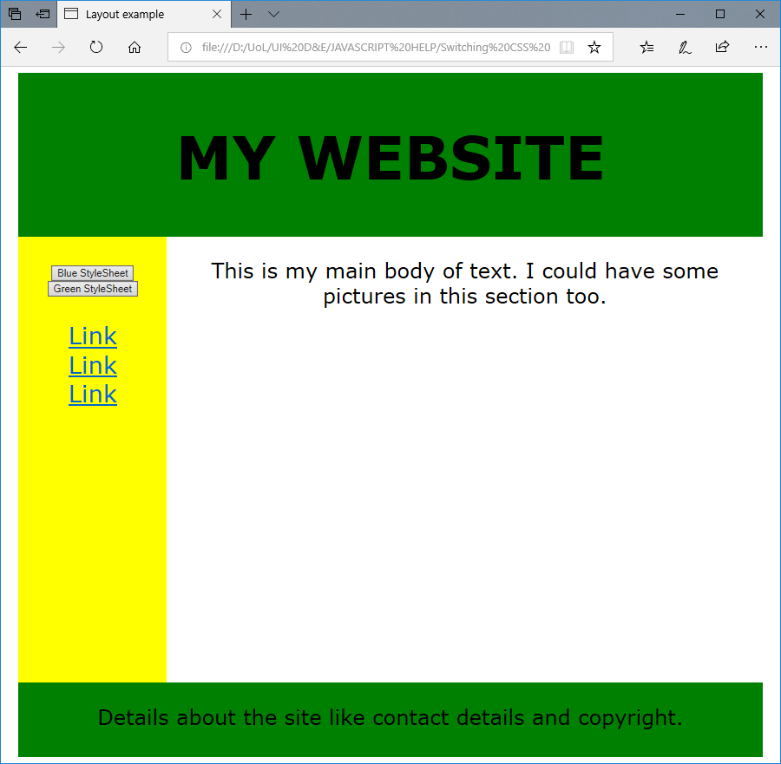
A starting point.
To start with I made a simple copy of my existing CSS file (called MyCSS.css) and called it AlternativeCSS.css.
I then altered some of the colours and font styles in order to make it look different.
My example is an extreme change just so you can see the difference.
This is the same web page but using a different CSS.

Slide 5
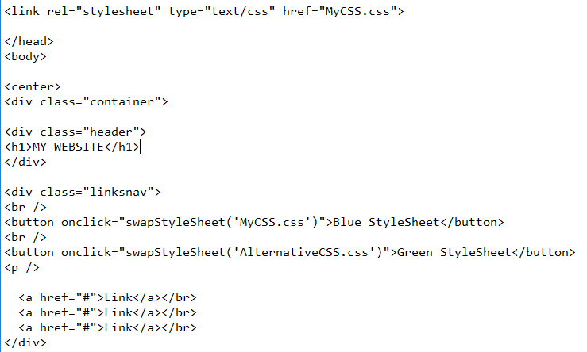
Changes to the HTML File – adding buttons
I then had to add 2 buttons the HTML page.
I have placed these buttons within the linksnav DIV class so they appear at the top of the link menu.
You will notice each one is linked to something called “swapStyleSheet”, which is the name of the function I will be using in JavaScript to change the style sheets.
Then in the brackets are the names of my different stylesheet.
The <br / > is a single line break. This helps me put each button on a separate line.
The < p /> gives me a paragraph space.

Slide 6
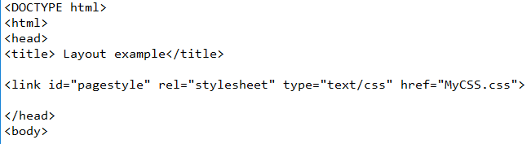
Changes to the HTML File – alter link to my CSS files.
The last thing you are left to alter is the link code for your CSS.
What you should have spotted is that I have added some additional text to the link to the CSS.
You will have noticed I have now given it an ID. This is because I need to reference the link to my CSS from my JavaScript.
My ID for referencing my stylesheet is “pagestyle”

Slide 7
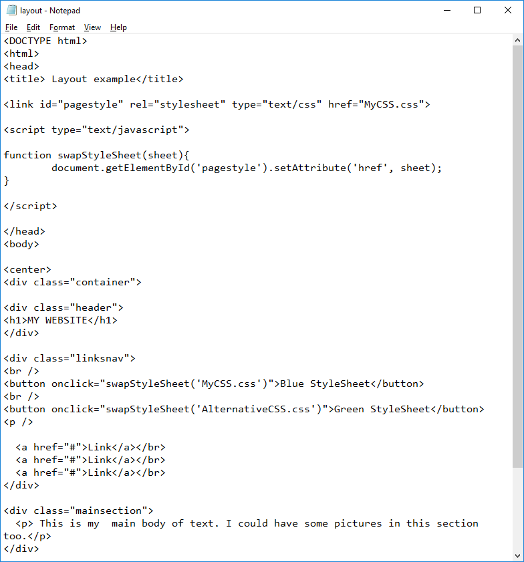
Now for the JavaScript
As this is going to be only 2 lines of code I have decided to add this to the top of my HTML.
But if you have a number of functions for a single page (like code for your menus) this would be better running from its own JavaScript file.
This is what my code looks like.
This will be explained on the next slide.

Slide 8
Now for the JavaScript
This is declaring the following code as JavaScript, and will be in a text format.
This is saying to select the item within the HTML with the ID found within the brackets (i.e. the link to the CSS)
This is setting the attributes for the this item. The attributes it is changing is the ‘href’,
The function is called swapStyleSheet, which we reference to in our button code in the HTML
The sheet part is an attribute that holds the option selected from whichever button is pressed.

Slide 9
Now to test your code.
You should see that when you run your HTML code you will have two buttons placed on the links navigation bar.
When you click on each the appearance of the page changes in accordance to the CSS you have chosen.

Slide 10
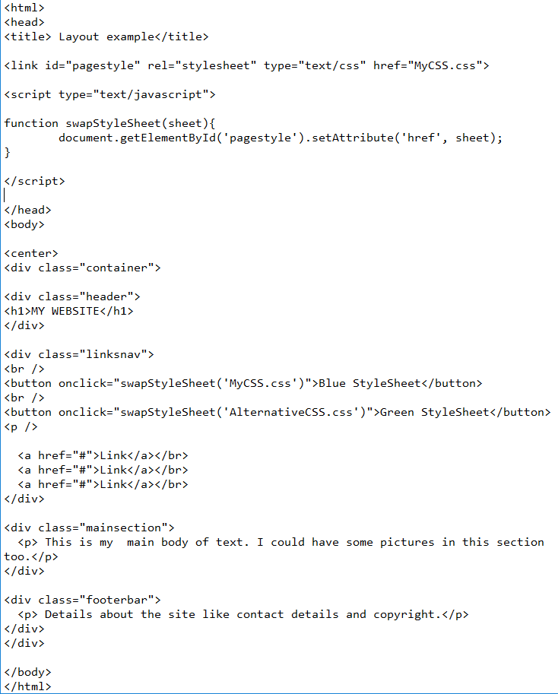
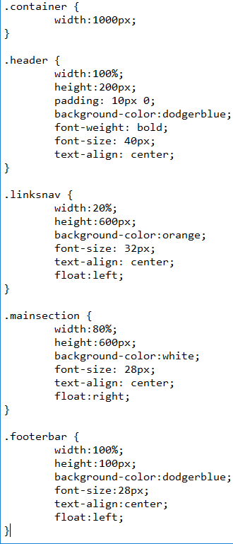
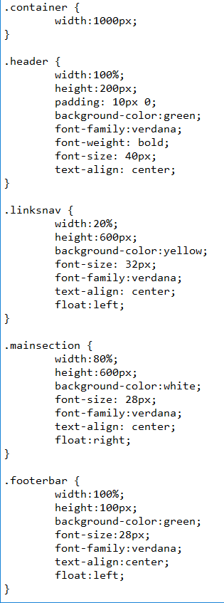
The final code…
MyCSS.css
AlternativeCSS.css

Slide 11
Useful links…
For CSS and general HTML support
https://www.w3schools.com/css/default.asp
For support with HTML layout
https://www.tutorialspoint.com/html/html_layouts.htm
For the options for colours you can use in HTML.
https://www.rapidtables.com/web/css/css-color.html#cyan

